Slide 1
process
Process scheduling

Slide 2
Scheduling Queues
As processes enter the system, they are put into a job queue, which consists of all processes in the system. The processes that are residing in main memory and are ready and waiting to execute are kept on a list called the ready queue.
This queue is generally stored as a linked list. A ready-queue header contains pointers to the first and final PCBs in the list. Each PCB includes a pointer field that points to the next PCB in the ready queue.
The list of processes waiting for a particular I/O device is called a device queue. Each device has its own device queue.

Slide 3
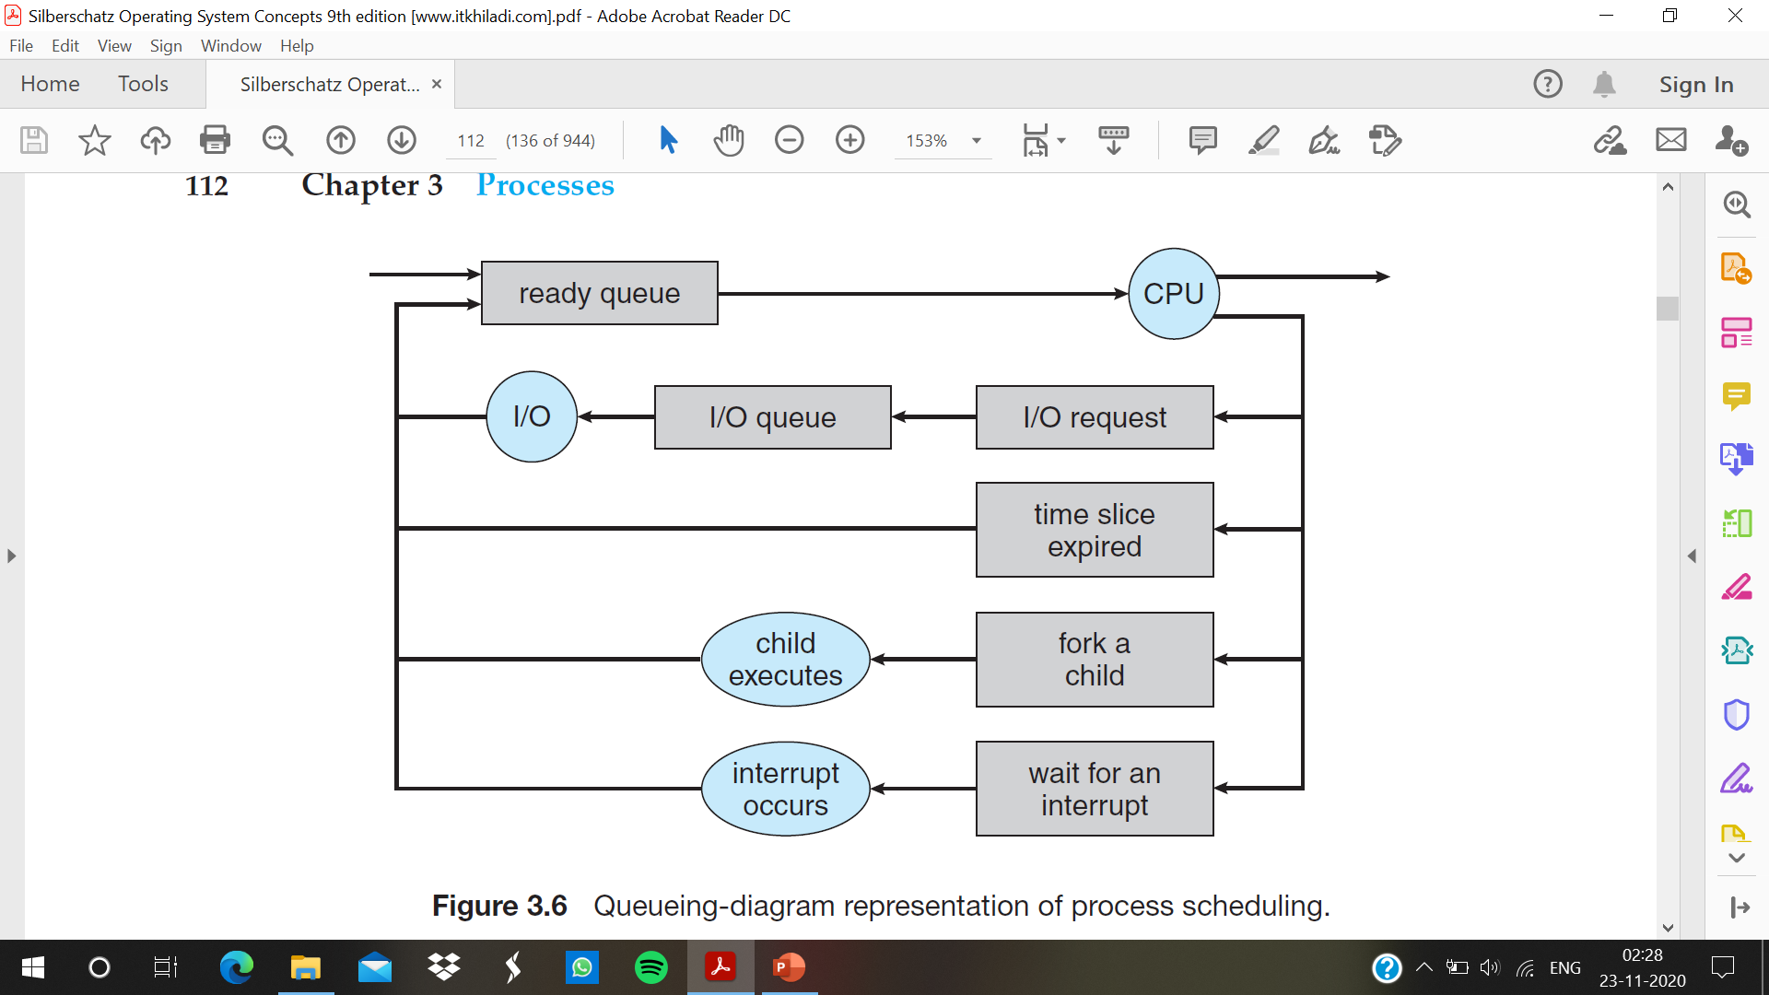

Slide 4
A new process is initially put in the ready queue. It waits there until it is selected for execution, or dispatched. Once the process is allocated the CPU and is executing, one of several events could occur:
• The process could issue an I/O request and then be placed in an I/O queue.
• The process could create a new child process and wait for the child’s termination.
• The process could be removed forcibly from the CPU, as a result of an interrupt, and be put back in the ready queue.

Slide 5
Schedulers
processes are spooled to a mass-storage device (typically a disk), where they are kept for later execution. The long-term scheduler, or job scheduler, selects processes from this pool and loads them into memory for execution.
The short-term scheduler, or CPU scheduler, selects from among the processes that are ready to execute and allocates the CPU to one of them.
The primary distinction between these two schedulers lies in frequency of execution. The short-term scheduler must select a new process for the CPU frequently.
The long-term scheduler executes much less frequently; minutes may separate the creation of one new process and the next.

Slide 6
Why long term scheduler take more time ?
The long-term scheduler controls the degree of multiprogramming (the number of processes in memory).
If the degree of multiprogramming is stable, then the average rate of process creation must be equal to the average departure rate of processes leaving the system.
Thus, the long-term scheduler may need to be invoked only when a process leaves the system. Because of the longer interval between executions, the long-term scheduler can afford to take more time to decide which process should be selected for execution.

Slide 7
I/o vs CPU –bound process
An I/O-bound process is one that spends more of its time doing I/O than it spends doing computations.
A CPU-bound process, in contrast, generates I/O requests infrequently, using more of its time doing computations.
It is important that the long-term scheduler select a good process mix of I/O-bound and CPU-bound processes. If all processes are I/O bound, the ready queue will almost always be empty, and the short-term scheduler will have little to do. If all processes are CPU bound, the I/O waiting queue will almost always be empty, devices will go unused, and again the system will be unbalanced.

Slide 8
medium-term scheduler
The key idea behind a medium-term scheduler is that sometimes it can be advantageous to remove a process from memory (and from active contention for the CPU) and thus reduce the degree of multiprogramming. Later, the process can be reintroduced into memory, and its execution can be continued where it left off. This scheme is called swapping.
The process is swapped out, and is later swapped in, by the medium-term scheduler. Swapping may be necessary to improve the process mix or because a change in memory requirements has overcommitted available memory, requiring memory to be freed up.

Slide 9
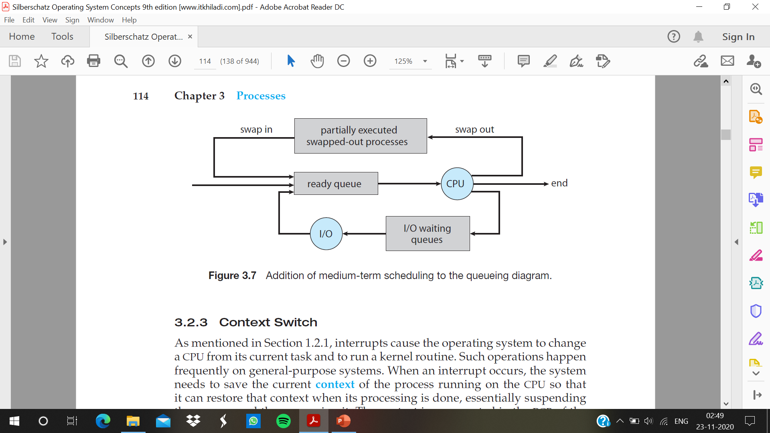

Slide 10
Context Switch
When an interrupt occurs, the system needs to save the current context of the process running on the CPU so that it can restore that context when its processing is done, essentially suspending the process and then resuming it.
It includes the value of the CPU registers, the process state and memory-management information. Generically, we perform a state save of the current state of the CPU, be it in kernel or user mode, and then a state restore to resume operations.
Switching the CPU to another process requires performing a state save of the current process and a state restore of a different process. This task is known as a context switch . When a context switch occurs, the kernel saves the context of the old process in its PCB and loads the saved context of the new process scheduled to run

